Slide 1

Identifying At-Risk Patients
Presented by:
Jennifer Sullivan Nate Evans
Lily Cook
Notes:
Lily will introduce the project and do slides 1-4
Nate will discuss slides 5-6
Jennifer will do slides 7-8

Slide 2
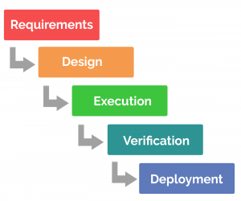
Overview
But how can we argue for deployment if we don’t understand the requirements?
In this class, we’ve primarily focused on these components of a project, with emphasis on LACE model development.
This presentation is an opportunity to argue for the value of our models performance.

Slide 3
Overview
In this presentation, we’ll…
Outline the critical need motivating this project
Review our preliminary model development
Discuss application, interpretability and value of our model
Take a step back and ask, what is the value of implementing THIS model?
And how do we make a data-driven decision?
Notes:
We are asking for more resources to continue to hone the model so we can reduce readmissions. for patient health and maximizing reimbursement (avoid penalties) means a better allocation of resources.

Slide 4
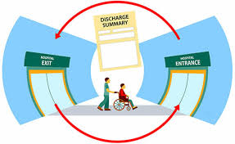
Why change?
Current tools for patient risk are problematic; Physicians are only correct 40% of the time.
Hospital readmissions cost us $1 million in lost Medicare revenue.
Highest-risk patients are 5% of our patient population, but 80% of our treatment cost.
Notes:
Make progress on risk stratification,
[choosing a cutoff for sensitivity and specificity]
Spend a few minutes establishing a fact based need for change. Use existing organizational performance metrics, published studies, and current organizational problems to frame the need for change. Do not introduce editorial or build connections to the future yet. You are using facts to explain the current state.
Again, spending too much time justifying the need for change is the most common analyst presentation trap I witness! Your audience already knows the problems if they work inside the organization. Use this to pinpoint which specific pain points your model will help address.
Think about how we are going to measure the return on investment.

Slide 5
Impact of not changing
Our population is aging
Reactive, not preventive
As we transition away from fee-for-service model, penalties for missed benchmarks will increase
Lower quality of life for patients at the end-of-life
Notes:
More and more high-risk patients
Our current model means we are only reacting to events, unable to anticipate change and not as focused on preventive care as we could be
Healthcare systems are moving away from fee-for-service, so we need to start thinking in terms of accountable care in order to avoid financial penalties and maximize reimbursement
If we can't anticipate which patients at the highest-risk, we will be unable to help them prepare for end-of-life

Slide 6
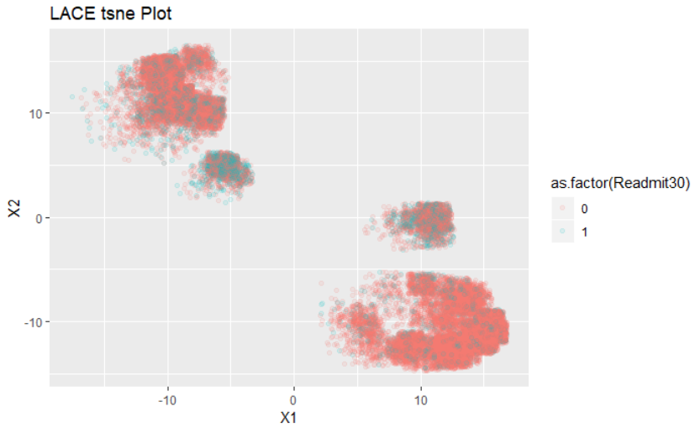
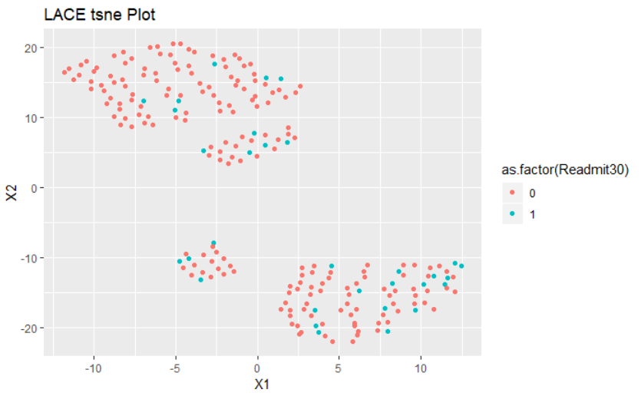
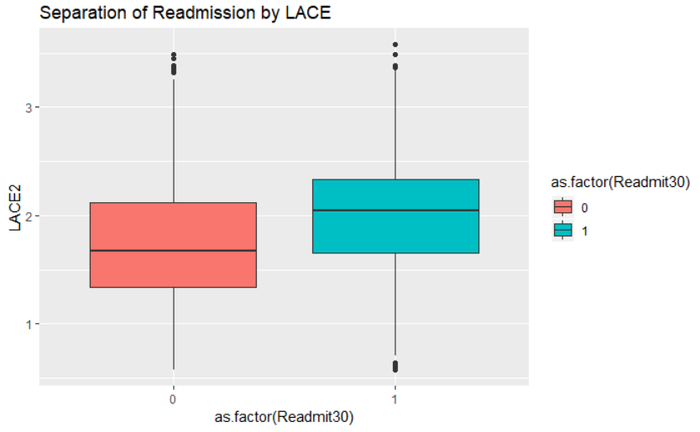
Preliminary Model Development
Exogenous Features: LACE metric
(Ottawa Hospital Research Institute LACE Index Scoring Tool for Risk Assessment of Death and Readmission)
Notes:
Dataset
N ~ 35,000
Comorbidities
- Congestive heart failure (CHF)
- Peripheral Vascular Disease (PVD)
Increase accuracy of predictive power. More time for development to increase predictive power and boost performance. Those resources should be dedicated to testing additional features/variables.
Explain the solution at a high level before going into detail – i.e., broad explanation, tie it t a workflow, how it is a transitional model, (DON’T define what the acronym LACE means, but how it’s implementation will be used w/in the organization. Make it a well-told story.
Skipping the high level and jumping straight to the detail is the second most frequent analyst presentation mistake I see. Give your audience the big picture first so they can better understand and relate to the component parts. This will save you from interruptions and increase their understanding.
The bulk of your presentation should focus on the solution (this section plus the next two)

Slide 7
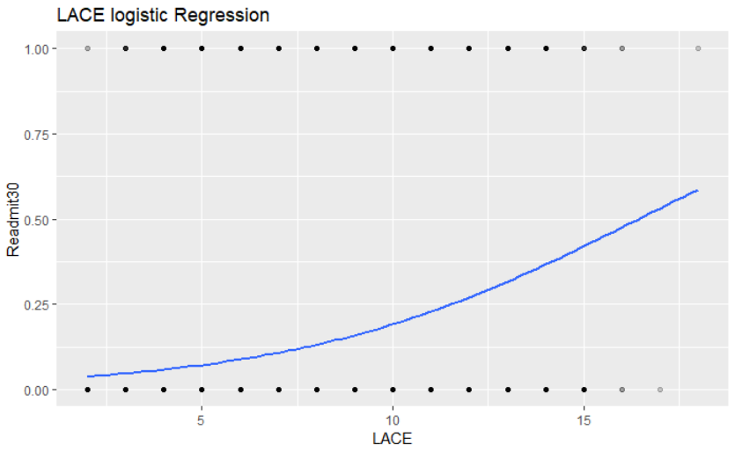
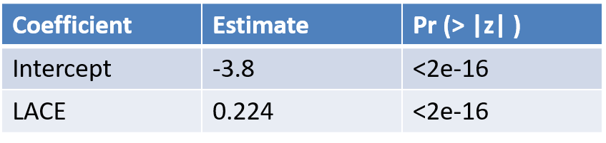
Preliminary Model Development
LACE metric weighted by coefficients of multivariate regression on L,A,C,E features.
Highly significant coefficients

Slide 8
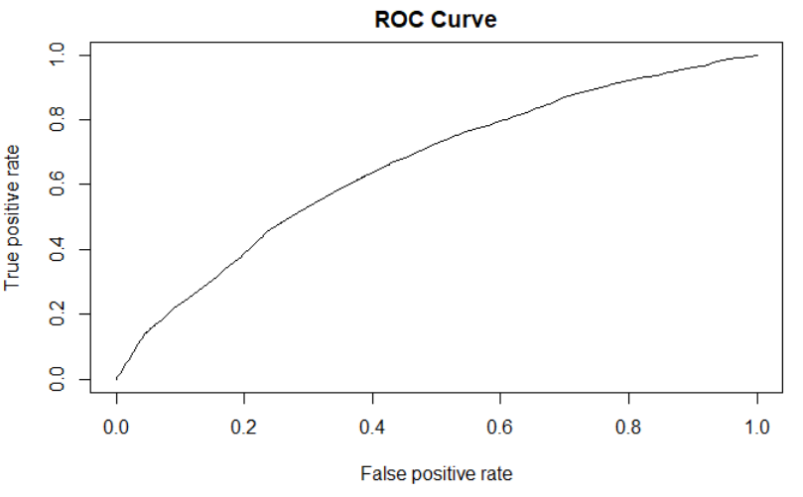
Preliminary Model Development
AUROC
0.66
Threshold [Ideally] chosen by maximizing Youden’s index (Sensitivity + Specificity – 1)
Threshold = 0.2 | Number
Correctly Predicted Readmissions (TP) | 2019 (5.7%)
Incorrectly Predicted Readmission (FP) | 5986 (17.1%)
Correctly Predicted Non-readmission (TN) | 22864 (65.3%)
Incorrectly Predicted Non-readmission (FN) | 3025 (8.6%)

Slide 9
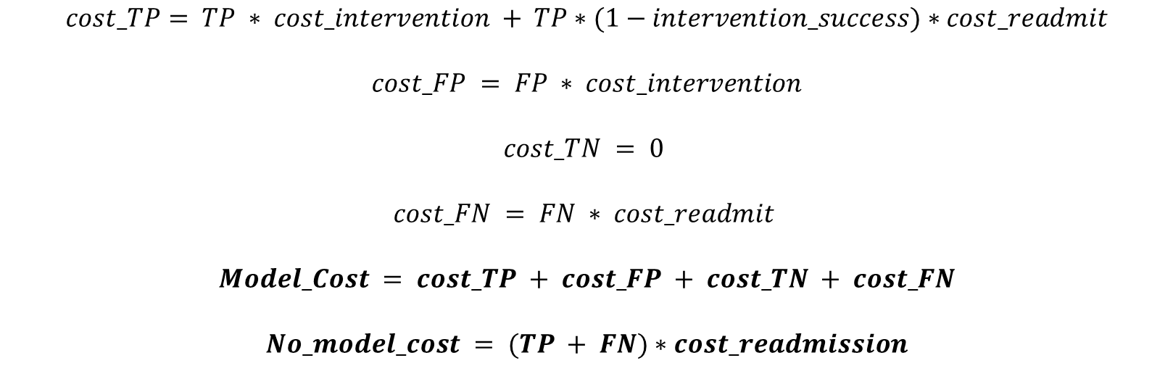
What is good enough?
Cost-Benefit Analysis – Rshiny App
$$cost_TP= TP ∗ cost_intervention + TP∗(1−intervention_success)∗cost_readmit$$
$$cost_FP = FP ∗ cost_intervention$$
$$cost_TN = 0$$
$$cost_FN = FN ∗ cost_readmit$$
$$Model_Cost = cost_TP + cost_FP + cost_TN + cost_FN$$
$$No_model_cost = (TP + FN)∗cost_readmission$$

Slide 10
Model Justification
80%
Improved model
66%
Current model
40%
Physician judgment
Health
Safety
Patient choice
Quality of life

Slide 11

Users
Transition of care team
Incorporate information into discharge orders ​
Referrals to palliative care, case management, check-ins​
https://www.tehrantimes.com/news/421384/Iran-to-set-up-palliative-care-centers-for-cancer-patients

Slide 12
Financial Benefits
Anticipated reduction of readmissions: 25%
Anticipated increase in Medicare reimbursement: $250,000/yr
Monitoring/preventive care is less expensive than inpatient treatment
Recoup investment w/in: 6 months
Automated score w/in the EHR = low maintenance costs

Slide 13
Your Role / Sponsorship
Corporate backing
Resources
Access to information
Age
Gender
Pharmacogenomic data
3 FTE for 3 months
Notes:
Our group(???): Authority to roll out a larger implementation, and resources (dedicated time, money, staff/people power) and their backing as a champion of the project.. Give them something PHYSICAL and TANGIBLE they can pass along to others. Keep in mind that the presentation should be comprehensible even by someone who didn’t attend the presentation, because it may be passed around w/in the organization. Access to this specific data, this specific amount of time, this amount of money and FTE.
End with action!
Specifically detail what you need your audience to do in order to make this effort a success.
Think of this as the positive benefits that offset the negative consequences you highlight earlier.
Leave your audience with a clear sense of what they need to do individually to drive success when the leave the room.

Slide 14
Thanks ☺
Questions?

